Slide 1
Early to Mid Career Fellowship Roadshow
Rutherford Discovery Fellowship
Rutherford Foundation Postdoctoral Fellowship
JSPS Postdoctoral Fellowship (for research in Japan)
HFSP Fellowships (see Catalyst Fund roadshow presentation)
The roadshow will give an overview of the Early to Mid Career Fellowships administered by the Royal Society Te Apārangi, and provide an opportunity to ask questions about the application process.

Slide 2

About the Society:
  Representation for ~1,600 members and ~20,000 constituent members
  Operates under an act of parliament (focus strategic priorities)

Slide 3

Who are we?
We support New Zealanders to explore, discover and share knowledge
We foster a culture that supports science, technology, and the humanities by:
    raising public awareness, knowledge, and understanding
    advancing education
We will encourage, promote, and recognise excellence
We support infrastructure for professional development
We maintain a Code of Professional Standards and Ethics
We provide expert advice on important public issues

Slide 4
Some things we do
Administer Government Research Funding Contracts
Projects
Fellowships
International Relationships
Celebrate Excellence in Science and Humanities
Fellows and Companions
Medals and Awards
Annual Research Honours Dinner
Science Media Centre
Help connect media with the scientific community
Science Media SAVVY workshops
Primary/Secondary Schools
Science Teacher Leadership Programme
Stimulate curiosity for/interest in Science and Technology (CREST, Powering Potential)
Engagement and outreach
Public Lecture series
  Speaker’s Science Forum
Emerging issues papers
New Zealand science journals

Slide 5
What can the Royal Society offer?
Framework of support
Career Support
Fellowships
James Cook Fellowships
Rutherford Foundation
Postdoctoral Fellowships
Rutherford Discovery Fellowships
Emerging career
Early-mid career
Later career
Marsden Fund STANDARD
Marsden Fund FAST-START
Project grants

Slide 6
The Rutherford Foundation
Objectives
The objectives of the Rutherford Foundation Fellowships and Scholarships are to support the education and development of promising excellent early career researchers with the potential to excel in a research environment. The funding opportunities support early career researchers who demonstrate a passion for research, science and technology, and have a strong sense of the purpose and benefits of research to New Zealand. Receipt of a Rutherford Foundation award is expected to have a significant value in the future career development of the supported Scholars and Fellows and help them to establish a foundation on which to embark on an independent research career.
Funding opportunities:
  Rutherford Foundation Postdoctoral Fellowship
  Cambridge-Rutherford Memorial PhD Scholarship

Slide 7

The Rutherford Foundation
  New Zealand Postdoctoral Fellowships
    2 years
    $75,000/year salary stipend
    $10,000/year research expenses
    Eligibility: 0-4 years post PhD

Slide 8
Rutherford Foundation Postdoctoral Fellowship
  Eligibility Criteria
  Proposals will be considered from all fields of research, science and technology (including social sciences and the humanities)
  Applicants are required to have had their PhD conferred no more than four years prior to the year the award is awarded. For the 2020 funding round, the PhD must be conferred after the 1st of January 2016.
            An exemption to this clause can be sought to allow applicants to demonstrate that their PhD has been submitted and can be examined by the date of short-listing.
            A further exemption can be sought to demonstrate a reasonable absence from a research career, for instance to take parental leave or for extended sickness leave.
            Exceptions requires prior approval from Secretariat
  Applicants must be either New Zealand citizens, or have continuously resided in New Zealand for at least two years immediately prior to their application and hold, or are deemed to hold, a New Zealand resident visa.

Slide 9
The Rutherford Foundation
Focus on career development, not business as usual
Applicants should demonstrate a passion for research, science and technology and the potential to excel in a research environment
Tentative application dates: Open early June and close 06 August (TBC)
Changes for 2020:
Applicants asked for Vision Mātauranga statement or explanation for why this is not applicable
Submit CV on NZ RS&T common CV template
or more information:
  https://royalsociety.org.nz/what-we-do/funds-and-opportunities/rutherford-foundation/
Notes:
Focus on career development
More likely to be awarded to someone who moving to a new institution with a new supervisor rather than someone continuing on from their PhD with same supervisor at the same institution.
This does not mean you can’t stay at the same institution. However, you have to argue strongly for why this would be the best choice for your career.

Slide 10
Rutherford Discovery Fellowships
  The Rutherford Discovery Fellowships support New Zealand’s most talented early- to mid-career researchers.
  The Fellowships will develop and foster the future leaders in the New Zealand research, science and innovation sector. It will help them to develop a strong track record and allow them to compete with the best researchers in New Zealand and the world for mainstream research funds
  Aims to assist with the retention and repatriation of New Zealand’s top early- to mid- career researchers with international research experience
  Ten prestigious Fellowships of five years in length will be awarded on a competitive basis annually, for research based in a New Zealand host institution.

Slide 11

The 2012 MSI Review
Scheme seen as valuable
    Fills a critical gap
    Current Fellows stay in New Zealand
    Includes the humanities
Areas for improvement
    Focus on leadership of person not project
    Encourage more repatriation applicants
    Limit eligibility to 3-8 years post-PhD and remove tier structure
    Remove need to be permanently employed post fellowship
Not a postdoctoral or employment scheme

Slide 12
Eligibility
Applicants must:
have PhD conferred between 01 January 2012 – 31 December 2017
be either New Zealand citizens OR applicants who have continuously resided in New Zealand for at least three months prior to their application and hold, or are deemed to hold, a New Zealand resident visa.
be associated with a New Zealand-based research institution that can provide the appropriate support and facilities to enable the applicant to succeed in their Fellowship for the full five years of the Fellowship's term.

Slide 13
Eligibility
PhD conferred between:
01 January 2012 – 31 December 2017
Was your PhD conferred between three to eight years ago?
NO
Ineligible
Exemption (parental or sickness leave)
YES
Are you a New Zealand Citizen?
Have you been in New Zealand for three months prior to the deadline?
NO
NO
Ineligible
YES
YES
Do you hold, or are deemed to hold, a New Zealand resident visa?
Eligible
NO
Ineligible
Check visa type
YES
Eligible

Slide 14
Eligibility exceptions
The eligibility period may be extended under the following scenarios:
Extended sickness leave or part-time employment as a result of ongoing childcare responsibilities. Calculate pro rata for the year count.
Eligibility can be extended to take into account any career interruptions experienced due to being the primary caregiver for young children born since their PhD was awarded. If the applicant is the primary caregiver of a dependent child, the applicant is able to extend the period of eligibility by two years per child. The extension of two years per dependent child is inclusive of any periods of parental leave. There is no maximum identified
All extensions need prior approval by the RDF Secretariat
Additional Rules
Where an applicant has previously submitted an unsuccessful application, they should discuss their subsequent application with the Fellowship Coordinator before reapplying

Slide 15
Scheme operation
  The award will provide:
    A contribution of $70,000 per year towards the researcher's salary
    An annual award of $60,000 in research related expenses
    $30,000 per year for the host organisations
  At least 85% of the Fellow’s time must be dedicated to the research objectives identified in the proposal
  Attendance at an annual workshop is required

Slide 16
Selection Criteria
Applications are graded on three criteria:
In the case of applicants of the same calibre, preference will be given to applicants who:
  do not already have tenure or equivalent; or,
  are living overseas and will use the Fellowship to return to New Zealand to continue their research careers
Criterion | Weighting
Research Quality
Calibre of the applicant as a researcher | 60%
Assessment of the proposed programme of research | 20%
Leadership Quality
Calibre of the applicant as a research leader | 20%

Slide 17
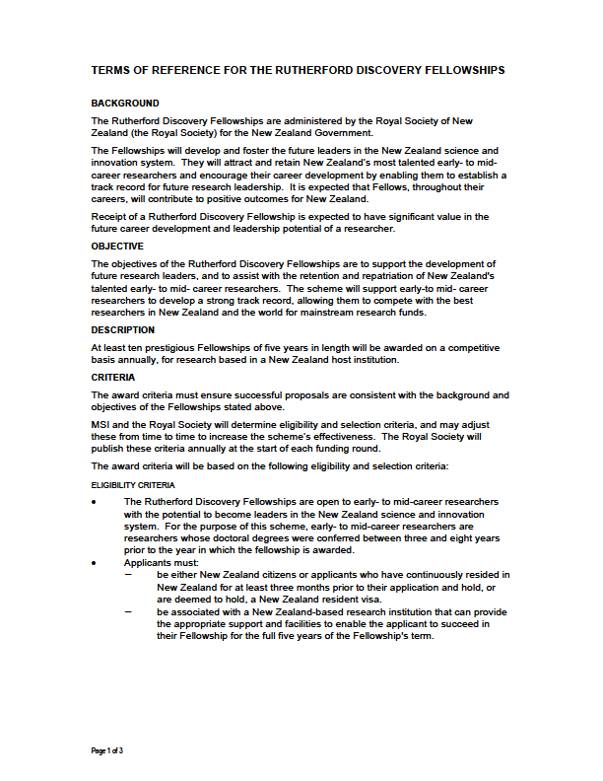
Are the Fellowships for you?
https://royalsociety.org.nz/what-we-do/funds-and-opportunities/rutherford-discovery-fellowships/
Use your support:
  Research office staff
  Mentors
  Head of Department
Terms of
Reference
Proposal
Guidelines
Referee
Guidelines
Panellist
Guidelines

Slide 18
Terms of Reference
BACKGROUND
The Rutherford Discovery Fellowships are administered by the Royal Society of New Zealand (the Royal Society) for the New Zealand Government.
The Fellowships will develop and foster the future leaders in the New Zealand science and innovation system. They will attract and retain New Zealand’s most talented early- to mid-career researchers and encourage their career development by enabling them to establish a track record for future research leadership. It is expected that Fellows, throughout their careers, will contribute to positive outcomes for New Zealand.
Receipt of a Rutherford Discovery Fellowship is expected to have significant value in the future career development and leadership potential of a researcher.

Slide 19
Funding round process
  A call for proposals will be made on 06 March
  Applicants will be required to submit their proposals along with three applicant-solicited referee reports using a web portal
  Three panels will assess the proposals:
    Humanities and the Social Sciences
    Life Sciences
    Physical Sciences, Engineering and Mathematics
  The discipline-based panels will recommend a long list of proposals to an interview panel co-opted by the President of the Royal Society Te Apārangi
  This interview panel will short list applicants to interview
  Ten Fellows will be appointed

Slide 20
Process of selection
Panel | No. of proposals submitted | Proposals submitted (% of total) | Long-list (number)
HSS | 16 | 14% | 6
LFS | 52 | 45% | 18
PEM | 47 | 41% | 16
Totals | 115 | 100% | 40
HSS
LFS
PEM
Discipline-based panel recommendation
6
18
16
Interview panel consideration
40
Call to interview
20

Slide 21

Preparing the application
  Follow the rules
  Writing tips:
    Write for your audience
    Avoid jargon
    Make every sentence count
    Define abbreviations and use them sparingly
    Avoid excessive use of might, maybe, could perhaps
    Avoid grammatical and spelling errors
    Make it as clear as you can
  Read the guidelines (see how you will be assessed)

Slide 22
Preparing the application
Building your CV
In the Rutherford Discovery Fellowship applications, CVs matter!
  Apply for awards and grants
  Serve professional bodies (panels, editorial boards, conference committees… )
  Write those unwritten papers prior to applying
  Publicise your research
  Seek collaboration
NZ RS&T-CV template
  Use section 1d “Present research/professional speciality” to introduce your research field.

Slide 23
Preparing the application
Years of Research Experience
Applicants must enter their years of research experience
Whole number of years minus periods of parental leave, medical leave or other career interruptions
Part-time work calculated on pro rata basis (e.g. 2 years at 0.5 FTE counts for one year of research experience)
      Indicate parental leave and research breaks in section 1e “Total years research experience ”

Slide 24
Preparing the application
Leadership
Use this space wisely, avoid repeating your CV (but could be used to expand on CV if needed)
Provide evidence of your leadership qualities:
    Student completions
    External funding awarded
If applicable, write about the future direction of your career
If possible, demonstrate:
    Team leadership roles
    Project management responsibilities
    Stakeholder relationships
    Collaboration network

Slide 25
Preparing the application
Leadership
Research leadership
non-discipline-specific leadership (e.g. leadership in Mātauranga Māori, community leadership, board and council positions/memberships, etc.) should be assessed equally to discipline-specific leadership.
Expected sources of evidence may include but are not limited to: team leadership roles; student numbers and completions; leadership in Mātauranga Māori; community leadership; board memberships; project management responsibilities; quality of stakeholder relationships; external grant funding as a named investigator; presence in relevant research communities; invitations to present keynote or plenary presentations; collaborator networks; knowledge transfer activity; significant contribution to achievement of commercialisation milestones; entrepreneurial activity; indications of peer-esteem; thought leadership (e.g., conceptual development of a research field internationally); and, direct policy facing or public engagement work. If appropriate, applicants may also indicate the future direction they wish to develop their leadership skills.

Slide 26
Preparing the application
Research
Not a Marsden project but a 5 year programme
Present an overarching research theme in the programme design and rationale
If appropriate, propose a number of objectives or projects to investigate
Good design and planning is essential:
  Be specific with your objectives and have a clear focus

Slide 27
Preparing the application
Referees
You will need to get three referees to review the calibre of you as a researcher, your leadership and your proposed research proposal.
  Referees should not be directly involved in the research (general rule is no co-publications last five years)
  Referees should not be in your chain of line management
  The referee reports are confidential – you will not see their comments
  At least one of these referees must be an international referee
  It is your responsibility to ensure the referee reports are received by the Society by the due date
  If the Society has not received 3 referee reports by the closing date and time, your application is invalid
  You can check the status of referee reports on the portal
  You have the option to add more than 3 referees. The Society will use the FIRST 3 referee reports received, at least one of which must an international referee

Slide 28
Amendments for 2020
All applicants are required to write a Vision Mātauranga statement. Applicants marking the proposal as ‘not applicable’ must provide a rationale for this decision.
Assessment of the applicant’s leadership quality has been amended to emphasise that non-discipline-specific leadership should be assessed equally to discipline-specific leadership. Examples could include leadership in Mātauranga Māori, community leadership; board and council positions/memberships, etc.

Slide 29
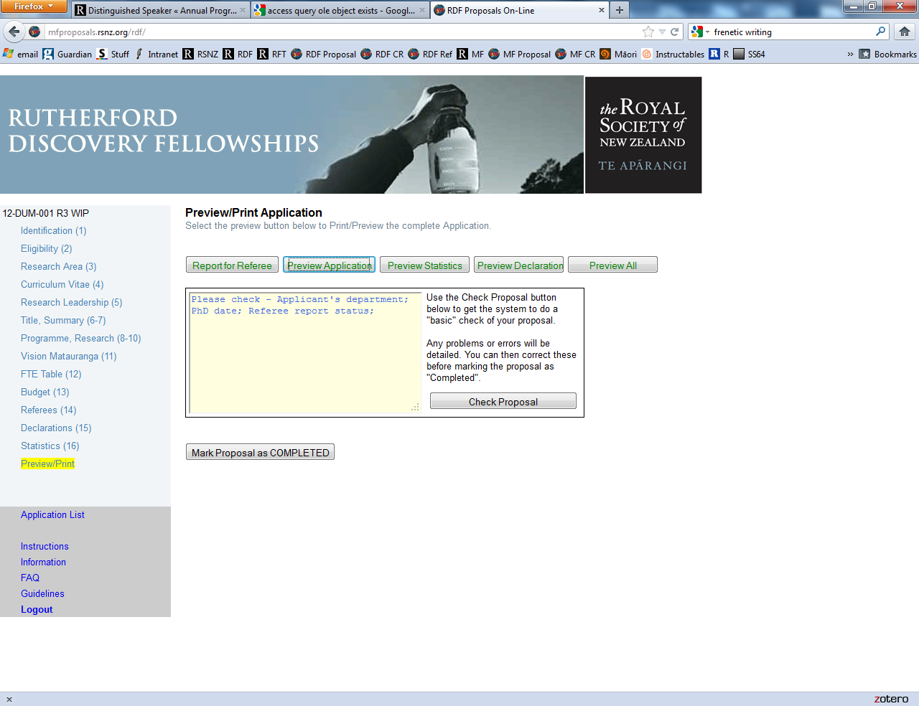
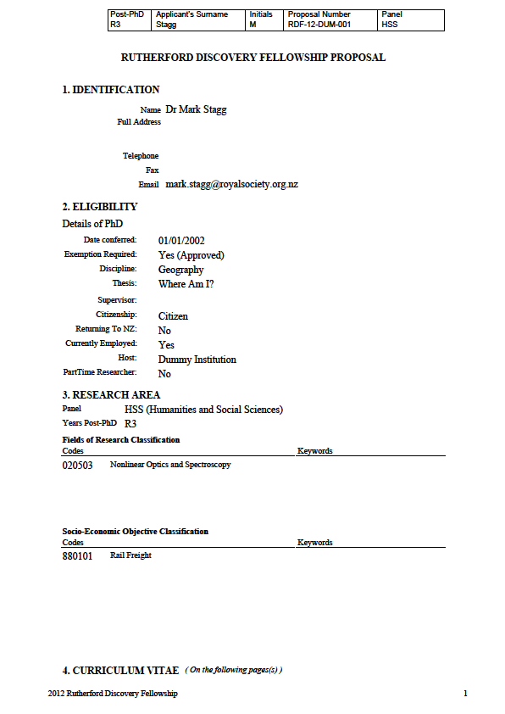
Proposals On-Line
Proposals are to be submitted on the web-based system, Proposals On-Line.
Researchers must contact their host institution’s research office coordinator to obtain their login details for the Proposals On-Line system.

Slide 30
2020 RDF Timetable
Date | Activity
Thu 05 March | Proposals On-Line web-based application system opens.
Thu 16 April | On-Line web portal closes at 5 pm (New Zealand Standard Time).
Thu 21 May | Deadline for receipt of applicant-solicited referee reports by the Secretariat of the Rutherford Discovery Fellowships at 5 pm (New Zealand Standard Time).
Thu 02 July | Last day for discipline-based panellists to submit their recommendations to the Secretariat.
Early Jul | The long-listed proposals are sent to the interview panel.
Tue 11 Aug | Last day for interview panellists to submit their recommendations to the Secretariat.
Mid to late Aug | Interview panel selects a short list of candidates to interview.
September | Interviews conducted by the interview panel. Dates to be confirmed.
Oct (TBC) | Results announced.

Slide 31
Interview
  The interviews are 20 minutes in duration
  The first ten minutes are an opportunity to outline your proposal
    A data show will be available and if desired you can present up to six PowerPoint slides
  For the remainder of the interview the panel will engage with you in a question and answer format
  Non-successful interviewees are encouraged to contact the Chair of the Interview Panel for feed-back

Slide 32
Feedback
We will ask whether you wish to receive feedback in the form of quartiles
A general statement with summary statistics about the funding round will also be prepared

Slide 33
Japan Society for the Promotion of Science – Postdoctoral Fellowships
Activity Description
The programme provides opportunities for young postdoctoral researchers from New Zealand to conduct, under the guidance of their Hosts, co-operative research with leading research groups in Japanese universities and research institutes.
Fellowships
Up to 5 fellowships may be awarded in this funding round, depending on the quality of applications received.
The period of fellowship is from 12 - 24 full months.
Value of the Award
The award will cover:
A round trip air-ticket (based on JSPS regulations)
A monthly maintenance allowance of ¥362,000
A settling in allowance of ¥200,000
Overseas travel accident and sickness insurance coverage.

Slide 34
Eligibility JSPS – Postdoctoral Fellowships
Start date:
JSPS requires that awarded Fellowships commence between 1 April 2020 and 30 November 2020. The Society strongly recommends a Start Date of 01 September 2020 or later to allow for JSPS processing time.
Applicants must meet all of the JSPS criteria:
  Applicant must hold a doctorate degree, or be scheduled to receive a doctorate degree before the chosen start date of the Fellowship.
  The doctorate degree must have been awarded on or after 2 April 2014.
  Applicants must have arranged in advance a research plan with their host in Japan
How to apply: Submit application through the Society’s Catalyst Fund Application Portal. Closing date: 23 April, 2020
More Information: Catalyst: Leaders website:
https://royalsociety.org.nz/what-we-do/funds-and-opportunities/catalyst-fund/catalyst-leaders/

Slide 35
For more information
Troels Petersen
Programme Manager - Research Fellowships & International
(04) 470 5764
Rutherford Discovery Fellowship
Email:rutherford.discovery@royalsociety.org.nz
Website: https://royalsociety.org.nz/what-we-do/funds-and-opportunities/rutherford-discovery-fellowships/
Rutherford Foundation
Email:Rutherford.Foundation@royalsociety.org.nz
Website: https://royalsociety.org.nz/what-we-do/funds-and-opportunities/rutherford-foundation/
Catalyst Fund (RSNZ)
Email:International.Applications@royalsociety.org.nz
Website: https://royalsociety.org.nz/what-we-do/funds-and-opportunities/catalyst-fund/

Slide 36
RDF Eligibility calculator
https://royalsociety.org.nz/assets/Uploads/Career-gaps-calculator-adapted-for-RDF-2019.xlsx

