Slide 1
ORCID Promotion within Member Organisations
New Zealand ORCID Consortium 12/10/2023
orcid@royalsociety.org.nz
Alex Freemantle – ORCID Lead, Royal Society Te Apārangi 0000-0002-0535-0662

Slide 2

Objectives
Benefits for researchers
Best practice for the promotion of ORCID to staff
Examples of promotion campaigns
Using the ORCID Member Portal
Q&A and Discussion
Notes:
Why now?

Slide 3
ORCID – The Three Main Services
An ORCID Record – Can include employment, education, funding, professional activities, peer review, research outputs and other metadata
An ORCID iD – A unique, persistent identifier free of charge to researchers
A set of APIs – The service and support that enable interoperability between an
ORCID record and member organisations
Beneficial to researchers, institutions, employers, funders…

Slide 4
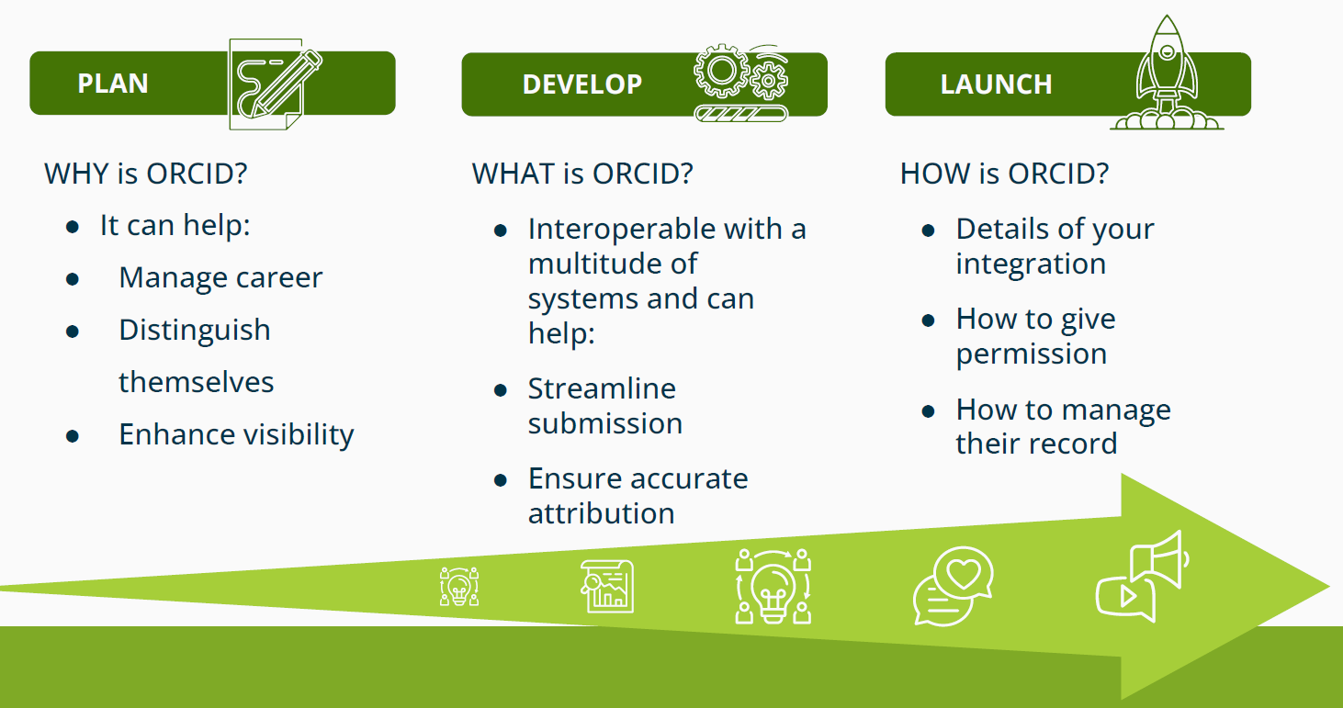
ORCID Inc – “How to talk about ORCID”
How many people have watched the recording or looked at the slides for the ORCID Inc global event entitled “How to talk about ORCID”?
Key takeaways:
Stakeholder Value Stories and example soundbites
Plan, Develop, Launch

Slide 5
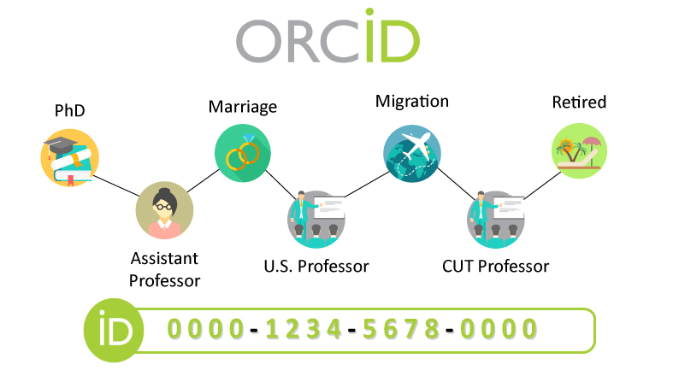
Recap the Benefits for Researchers
ORCID Value Stories
https://info.orcid.org/researchers/

Slide 6







ORCID Value Story - Researchers
All your research information accessible via your own unique profile, to be used wherever you need it.
 | Uniquely yours. Distinguish yourself and claim credit for your work while controlling access to your data, no matter how many people have your same (or similar) name.
 | Name flexibility. ORCID helps reduce the negative consequences of name changes so you will no longer be limited to the name you used when you began your career.
 | More time for research. By allowing trusted organizations to add your research information to your ORCID record, you can spend more time conducting your research and less time managing it!
 | Control your visibility and discovery. ORCID links all your research together, while you control the visibility of each piece of data. Easily see links to your research activities in one place—affiliations, funding, publications, and other contributions.
 | Reduced administrative burden. Experience greater ease as an increasing number of manuscript submission and grant application forms can be auto-populated when you log into their systems with your ORCID. Spend less time re-entering your data!
 | Portable profile data. Easily share the data in your record with an increasing number of funding, publications, data repositories, and other research workflows.

Slide 7
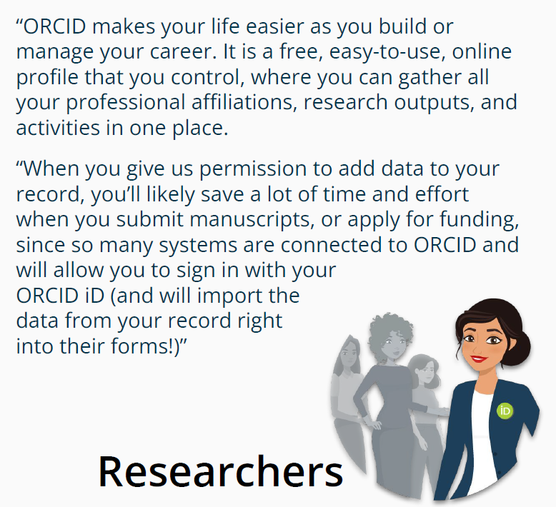
Talking to researchers about ORCID

Slide 8
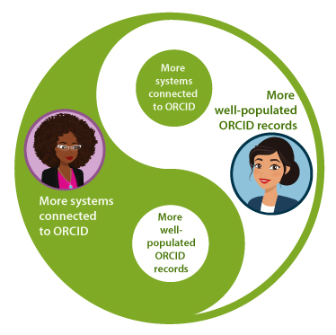
Recap the Benefits for Researchers
ORCID Value Stories
https://info.orcid.org/researchers/
Institution specific benefits
NZ ORCID Hub
Granting permissions
CV Tool

Slide 9
Best Practice for Promotion
Anticipation
Develop a clear plan within your organisation
ORCID Taskforce
Map out integrations
Provide initial ORCID education for researchers and inform them that action will be required soon
Resources – bulletin, newsletter, blog posts, webpage, merchandise

Slide 10
Best Practice for Promotion
2. Engage with ORCID
This is the action phase – you have raised awareness of the benefits of ORCID and now you want action from your staff
Point staff to your planned ORCID integration workflow
Encourage use of the NZ ORCID Hub
Search and Link Wizards
Active events – Faculty drop-in events, new term events, competitions, visits from RSTA
Notes:
Pushback

Slide 11
Best Practice for Promotion
Reiterate Key Messages about ORCID’s Value
Educate researchers so they know when to expect to use their ORCID account, how to recognize ORCID branding, and they can explain how re-use of their ORCID iD benefits them.
Strategically time reminders – grant application deadlines or common periods for submitting papers
Ideas for reminding researchers: e-posters on screens, ORCID IDs in email signatures, discuss ORCID consistently, presentations at conferences

Slide 12

Examples of Communication and Promotion Plans
Waipapa Taumata Rau | The University of Auckland
Ruth Wilson, Engagement Specialist, Centre for eResearch

Slide 13

Examples of Communication and Promotion Plans
University of Otago Communication Plan (Shiobhan Smith & Antje Lubcke)
This resource and others can be found on the Sharespace on our website
Anticipation Stage: Promotional email to all research staff, developed “ORCID at Otago” webpage, ORCID IDs on business cards and email signatures, promotional video
Engage with ORCID: Launch the campaign, ORCID screensavers appear, pop-up stall, ORCID on campus TV screens, distribute merchandise
Reiterate Messages: Identify future encounter sites, department newsletters, staff inductions
Notes:
Key advice:
Keep messages consistent
Point to sources of truth where appropriate
Brief and include all relevant team members involved in promotion across institution

Slide 14
Other Ideas and Discussions?
What other promotion ideas have you had for your research organisation?
Blogs
Staff inductions
Include information in training
Link to photo day
Presence at conferences/events
Videos
Visits from Royal Society Te Apārangi
Newsletters
Merchandise
Webpages
Competitions
ORCID Taskforce
Email signatures
ORCID fliers and posters
Screensavers
Targeted giveaways

Slide 15
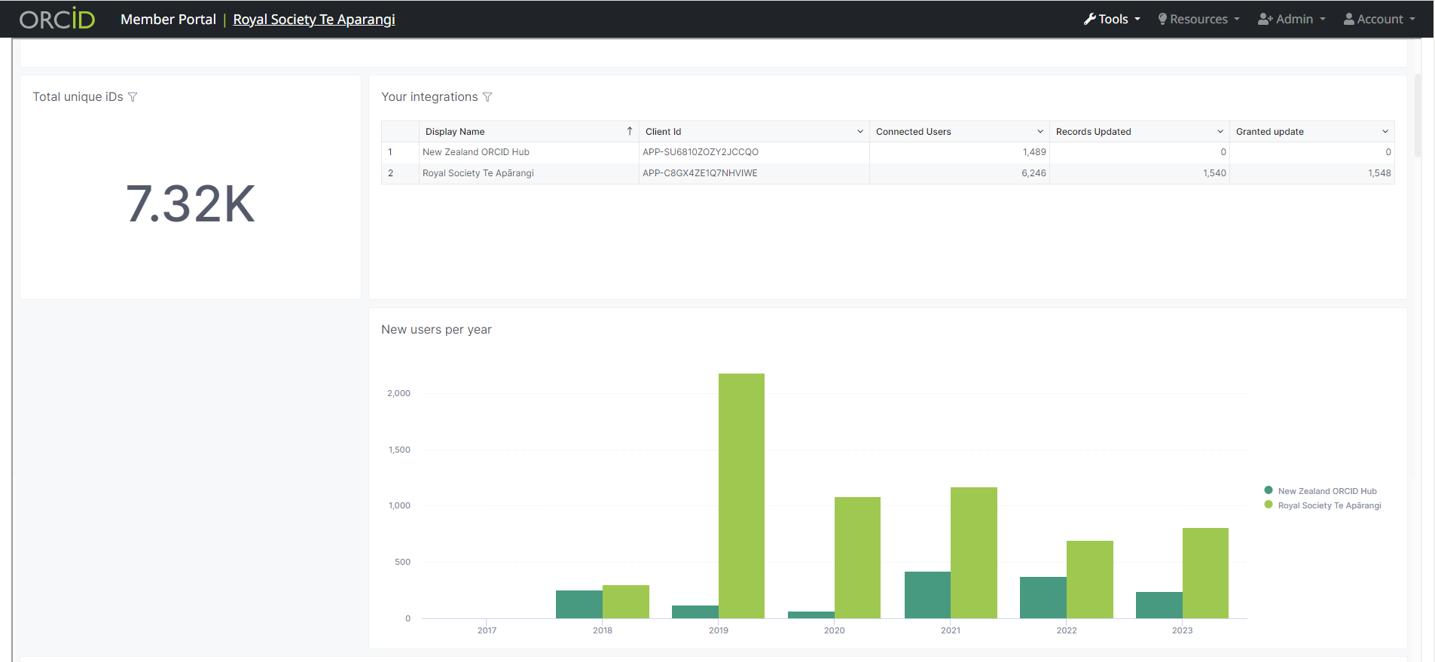
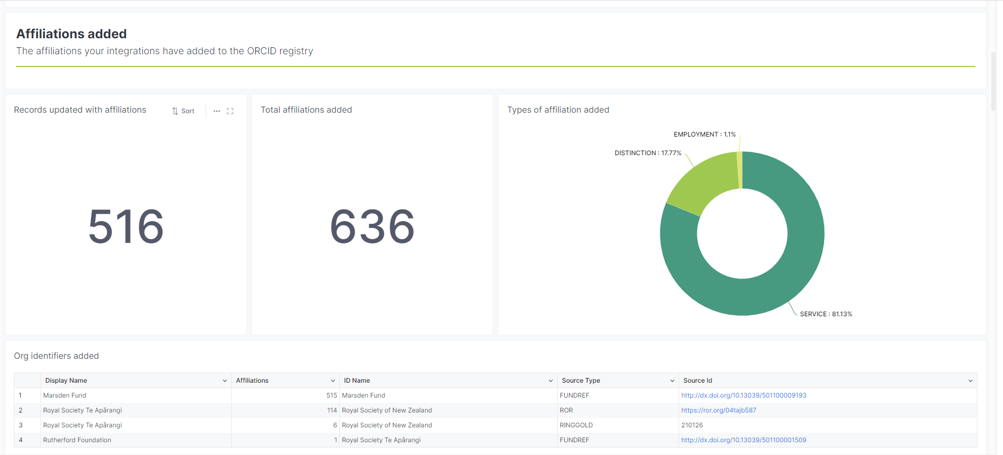
ORCID Member Portal
[member-portal.orcid.org]

Slide 16
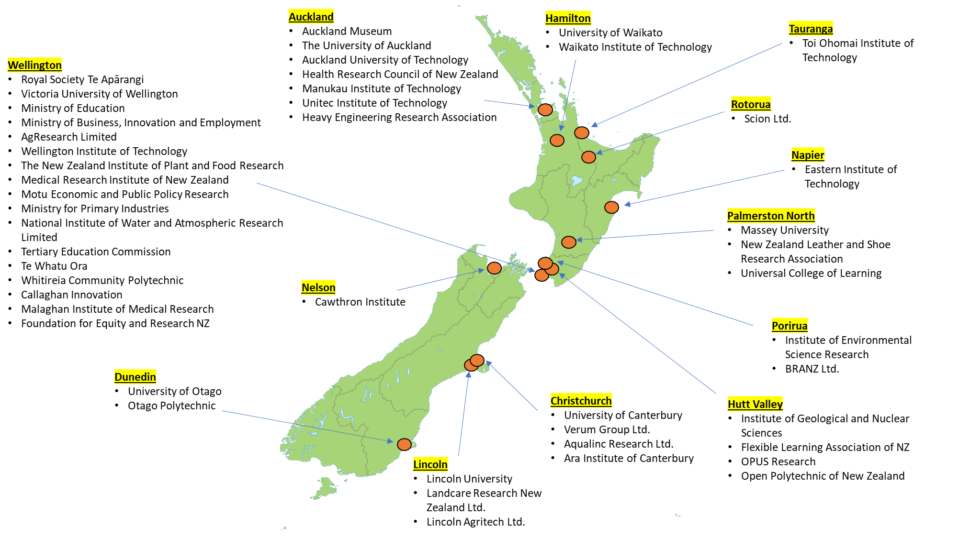
The New Zealand ORCID Consortium

Slide 17


Q&A
Any questions?
orcid@royalsociety.org.nz

