Slide 1

Catalyst Fund - advancing global science partnerships for New Zealand
The “Catalyst Fund” is the “new” name for the International Relationships Fund appropriation within Vote Business, Science and Innovation.
Supports activities that initiate, develop and foster collaborations leveraging international science and innovation for New Zealand’s benefit. The Catalyst Fund is delivered through four instruments:
        Catalyst: Influence
        Catalyst: Leaders
        Catalyst: Seeding
        Catalyst: Strategic

Slide 2
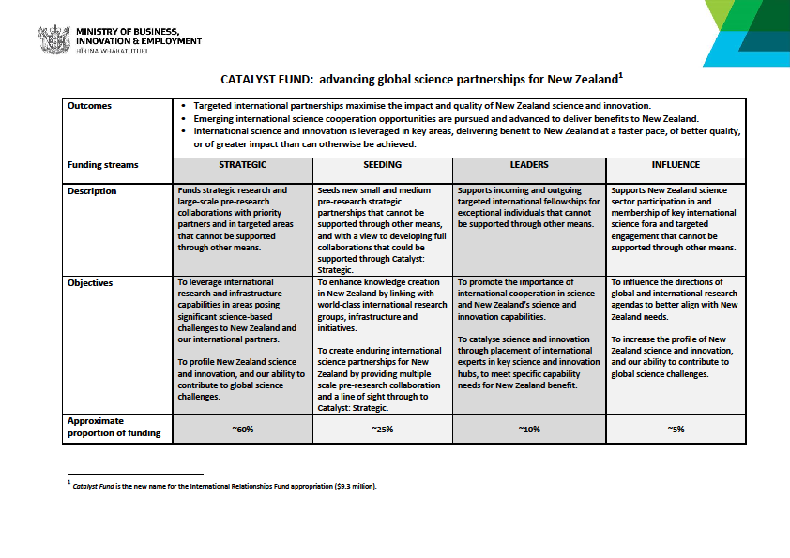

Slide 3
Catalyst: Seeding
Facilitates new small and medium pre-research strategic partnerships that cannot be supported through other means, and with a view to developing full collaborations that could be supported through Catalyst: Strategic over time.
Three annual calls
Call | Open Date | Close Date | Programmes
JANUARY | 26 January 2023 | 20 April 2023 | General
APRIL | 27 April 2023 | 20 July 2023 | General New Zealand - Germany Science & Technology Programme Dumont d’Urville NZ-France Science & Technology Support Programme
JULY | 27 July 2023 | 19 October | General New Zealand – Japan Joint Research Programme

Slide 4
Catalyst: Seeding
Programme | Partner | Application(s) Required | Allowable expenses | NZ$ Funding (GST exclusive)
General | International | New Zealand | Travel, research expenses, expenses related to hosting workshops | Up to $80,000 in total for up to two years
Sub-Programme
New Zealand – Germany Science & Technology Programme | Germany | New Zealand and Germany | Travel and related expenses | Up to $80,000 in total for up to two years
Dumont d’Urville NZ-France Science & Technology Support Programme | France | New Zealand and France | Travel, research expenses, expenses related to hosting workshops | Up to $80,000 in total for up to two years
New Zealand – Japan Joint Research Projects | Japan | New Zealand and Japan | Travel, research expenses, expenses related to hosting meetings | Up to $60,000 in total for up two years

Slide 5
Catalyst: Seeding General
Background
Supports new small and medium pre-research strategic partnerships that cannot be supported through other means, and with a view to developing full collaborations that could be supported through Catalyst: Strategic Fund/other funding.
Objective
To enhance knowledge creation in New Zealand by linking with world-class international research groups, infrastructure and initiatives,
To create enduring international science partnerships for New Zealand by providing multiple scale pre-research collaboration and a line of sight through to Catalyst: Strategic.
International Partner and Field of Research
open to collaborations with researchers from any country (incl. Japan, Germany, and France) within all fields of research, science and technology.
Funding
A maximum of NZ$80,000 (GST Exclusive) in total is available per Proposal for projects lasting up to two years. The funding is unilateral.

Slide 6
Ring-fenced bilateral Catalyst: Seeding programmes
New Zealand – Japan Joint Research Projects
Funding up to NZ$180,000 allocated to support New Zealand – Japan Joint Research Projects.
NZ funding up to $60,000 per proposal for New Zealand team.
Japanese team funding by Japan
Dumont d’Urville New Zealand-France Science and Technology Support Programme
Funding up to NZ$160,000 allocated to support the Dumont d’Urville Science and Technology round
NZ funding up to NZ$80,000 per proposal for New Zealand team.
French team funded by France
New Zealand-Germany Science & Technology Programme
Funding up to NZ$240,000 allocated to support New Zealand – Germany Science & Technology Programme
NZ funding up to NZ$80,000 per proposal
German team funded by Germany
Field of Research – must be related to Climate Change (physical processes, social-economic dimension and adaptation - TBC)

Slide 7
Catalyst Seeding assessment criteria
Criterion 1: Enduring collaboration (weight in assessment 30%)
Track record of the New Zealand PI and Collaboration Partner (relative to opportunity)
Clearly demonstrated excellence of the Partner Institution(s)
Potential of the collaboration to create an enduring partnership.
Ability of the Project Team to deliver on proposed activities.
Criterion 2: Novel knowledge and partnership (weight in assessment 40%)
How the Collaboration Partner will bring world-leading knowledge that complements the New Zealand Project Team members’ skills and knowledge.
How the proposed collaboration will support a new partnership or a new research focus for an established collaboration.
Criterion 3: Strategic benefits (weight in assessment 30%)
Ability to leverage international investment, facilities and infrastructure not available in New Zealand.
Clearly demonstrated pathway to build a substantive collaboration beyond an initial engagement that is in line with New Zealand’s science priorities.
Ability of Project Team to use the partnership to initiate links with relevant New Zealand research capabilities beyond the participating institutions.

Slide 8
Criteria 3: Criterion 3: Strategic benefits Contineud
Clearly demonstrated pathway to build a substantive collaboration beyond an initial engagement that is in line with New Zealand’s science priorities.
New Zealand science priority may refer to high priority research fields as evidenced by links to a CoRE, NSC, biodiversity documents, local government priorities, or any other science priority argued in the proposal.

Slide 9
Common feed-back for unsuccessful Catalyst Seeding applications
Inability to clearly demonstate that the proposed collaboration is a distinctively new focus for collaborarion partners that have previously worked together.
Not made clear how the project aligns with a New Zealand Science priority and what it will bring.
Demostrating exellence of partner instituion and collaborator
Demonstrating complimentary skills and the leverage of existing international expertise.
Inability to clearly articulate outcomes of the proposed project
Lack of demonstrated Māori engagement where this was deemed necessary by panellists
Inability to write to the assessment criteria

Slide 10
Catalyst Seeding and Horizon Europe
Following the agreement, in late 2022, between MBIE and the European Commission, on Treaty text for New Zealand’s Associate Membership of Horizon Europe, New Zealand researchers and their organisations can now participate in bids for funding under Horizon Europe Pillar II programmes on equal footing with their European counterparts.
The Catalyst Seeding programme is an excellent way to build European research connections if you’re thinking about a Horizon Europe bid but don’t yet have a strong collaboration with a European partner. However, no preference will be given in the Catalyst Seeding bid assessment processes to projects which involve European partners.
If you are interested in Horizon Europe but couldn’t make the recent MBIE roadshow meeting in your region, you can obtain a copy of the presentation made at the event - or have any questions regarding Horizon Europe Association answered - by e-mailing New Zealand National Contact Point NZNCP@mbie.govt.nz.

Slide 11
Catalyst: Leaders
Supports incoming and outgoing targeted international fellowships for exceptional individuals that cannot be supported through other means
Three annual calls
Call | Open Date | Close Date | Sub-programmes
JANUARY | 26 January 2023 | 20 April 2023 | International Leader Fellowships New Zealand - China Scientist Exchange Programme JSPS Postdoctoral Fellowships
APRIL | 27 April 2023 | 20 July 2023 | Julius von Haast Fellowship
JULY | 27 July 2023 | 19 October | HOPE Meeting (TBC)
Falling Walls Lab (separate application process)

Slide 12
Catalyst: Leaders
Sub-Programme | Brief Description | Duration | NZ$ Funding (excl. GST) | Awards
International Leader Fellowships | Supports exceptional individuals from any country outside New Zealand to catalyse science and innovation capability and capacity in New Zealand for a minimum of 4 weeks per year for up to 3 years | 1 to 3 years | Per annum: $20,000 Stipend $20,000 Research $10,000 Host admin | Up to 3
Julius von Haast Fellowship Award | Supports an internationally recognised researcher from Germany to undertake research in New Zealand for a minimum of 4 weeks per year | 3 years | Per annum: $20,000 Stipend $20,000 Research $10,000 Host admin | Up to 1
NZ-China Scientist Exchange Programme | Supports the development of research linkages with China by enabling New Zealand researchers to visit Chinese research organisations | 4 weeks | Flights and daily living allowance | Up to 10
JSPS HOPE Meeting | Supports excellent PhD students and/or young researchers to attend the HOPE meetings with Nobel Laureates in Japan | 5 days | Flights, accommodation, and meeting registration | Up to 5
JSPS Postdoctoral Fellowship* | Supports young and excellent New Zealand postdoctoral researchers doing research in Japan | 12 – 24 months | Flights, insurance and living allowance | Up to 5

Slide 13
New Zealand-China Scientist Exchange Programme
Objective
Encourage and facilitate greater understanding and development of research linkages between the two countries in jointly agreed priority research fields for collaboration.
Activity Description
Enable up to 10 excellent New Zealand researchers to travel to mainland China and collaborate with researchers in mainland Chinese institutes for a four-week period (2-6 weeks)
Researchers can visit more than one Chinese research institute as part of the exchange.
Beijing Orientation
Exchange is expected to start with orientation ceremony in Beijing on 18 October (unless otherwise approved by the Society and CSTEC)
Funding
Travel, accommodation and daily allowance (no funds for research costs).
Traveler is responsible for their own visa application, travel and medical insurance
Fields of Research
Preference will be given to those applications under the listed priority research fields:
Water Research
Food Safety and Security
Non-communicable disease.

Slide 14
International Leader Fellowship
Background
The Programme enables a Fellow to catalyse science and innovation capability and capacity development in New Zealand for a minimum of four weeks per year for up to three years.
Objective
To support the attraction by New Zealand Research Organisations (the Hosts) of international fellows who can have a catalytic impact on New Zealand science capabilities and promote the importance of international cooperation in science.
International Partner and Field of Research
open to researchers from all countries and all fields of research, science and technology.
Funding (per annum for up to three years)
NZ$20,000 maximum stipend paid to the Leader via the New Zealand Host;
NZ$20,000 maximum research and travel allowance* paid to the Host; and;
NZ$10,000 maximum host institution administration allowance paid to the Host.
* Travel allowance for International leader travelling to, and around, New Zealand

Slide 15
Catalyst Fund - advancing global science partnerships for New Zealand
How to apply:
Applications must be submitted through Catalyst Fund Application Portal
Contact your Research Office for log-in details
Current open call (January) closes on Thursday 20 April, 2020

Slide 16
Expression of Interest for Catalyst Reviewers:
To be considered for January Call, EOIs must be received 3 weeks before call closing date
For more information:
https://royalsociety.org.nz/what-we-do/funds-and-opportunities/catalyst-fund/reviewing-proposals/

Slide 17
For more information
Troels Petersen
Programme Manager - Research Fellowships & International
(04) 470 5764
Catalyst Fund (RSNZ)
Email:International.Applications@royalsociety.org.nz
Website:
https://royalsociety.org.nz/what-we-do/funds-and-opportunities/catalyst-fund/

Slide 18

  Established in 1989
  Supported by:
    Australia, Canada, France, Germany, India, Israel, Italy, Japan, Republic of Korea, Norway, New Zealand, Singapore, Switzerland, United Kingdom, United States of America, South Africa, European Commission
  Headquarters in Strasbourg, France (www.hfsp.org)
  Annual budget: ~ USD 60M = NZD 81M
  New Zealand Membership administered by Royal Society Te Apārangi on behalf of MBIE

Slide 19
HFSPO promotes and funds basic research
  innovative, cutting edge research to extend the frontiers of life sciences
  focused on the elucidation of the sophisticated and complex mechanisms of living organisms
HFSPO attaches the highest importance to
  scientific merit
  internationality (especially intercontinentality) and
  interdisciplinarity

Slide 20
Types of awards
    Research Grants (Program and Emerging Investigator Grants)
    Postdoctoral Fellowships
      Long-Term Fellowships - postdocs in the life sciences
      Cross-Disciplinary Fellowships - postdocs from non-biological sciences
Value and duration of awards
    Research Grants – Maximum US$ 450,000 per annum for 3 years
    Fellowships - living allowance as well as a research and travel allowance, 3 years
Timetable
    Research Grants – registration 21 March; Letter of Intent closes 30 March; Full invited appliicaation mid-September
    Fellowships – EOI 11 May; Full invited applications 28 September

Slide 21
Research Grants: Objectives
Stimulate novel, daring ideas and innovative approaches
  frontier research on the complex mechanisms of living organisms
  all levels of biological complexity
  preliminary results not required
Develop new lines of research through new interdisciplinary collaborations
  Team members from outside the life sciences, working together on bold, novel, potentially transformative ideas

Slide 22
Frontier-extending, paradigm-shifting research into the complex mechanisms of living organisms, from molecular level to complex biological systems
Basic life sciences novel, daring ideas, challenging current paradigms in the field, breaking barriers to knowledge
Innovative approaches with scientists from disciplines outside the traditional life sciences
  no routine research (“the next logical step”)
  no applications that can be funded by a national research funding body
  no teams composed of present collaborators
  no collaborations within a single country
Investigator driven - no specific areas prioritised other than “frontier extending”
Science without borders - no restriction on nationality (except first PI is from a HFSP supporting country)
Opportunities for scientists early in their careers

Slide 23
Research Grants
Research grants are provided for teams of scientists from different countries who wish to combine their expertise in innovative approaches to questions that could not be answered by individual laboratories.
Preliminary results are not required and applicants are expected to develop new lines of research through the research collaboration.
Highly competitive
Projects are expected to be at the frontiers of knowledge and therefore entail risk

Slide 24
Research Grants – Key Aspects
Three year grants
Success rate
  ~ 4% of original Letters of Intent are funded, and
  ~ 10% are invited for submitting full applications
  ~ 40% from final review panel meeting

Slide 25
Postdoctoral Fellowships
HFSP Fellowships
  Long-Term Fellowships - postdocs in the life sciences
  Cross-Disciplinary Fellowships - postdocs from non-biological sciences
For ambitious postdoctoral scientists to
  undertake frontier research
  move into new areas of study
  work in a new country
  broaden research skills and learn new methodology
  work in a top laboratory

